Slide 1

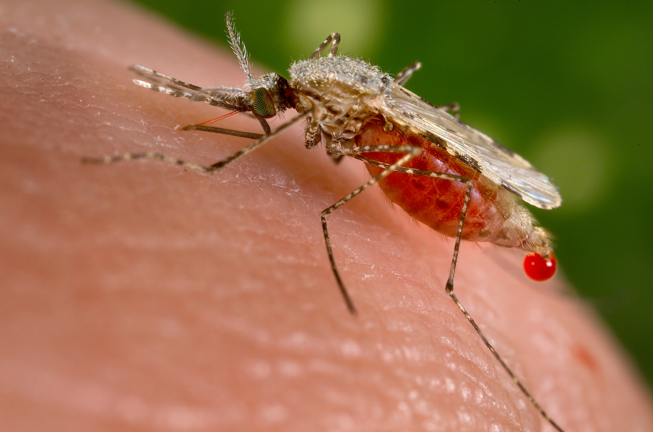

Group 4
Vallerian ,Violet Muscline, Godfrey
29.08.2025
Malaria Modelling with Vector Control and Treatment Interventions

Slide 2
Presentation Outline
Question
Flow Diagram of the question
Scenario 1:Vector Control
Scenario 2: Treatment
Scenario 3: Combined
Cost Effective Analysis
Policy Recommendation

Slide 3
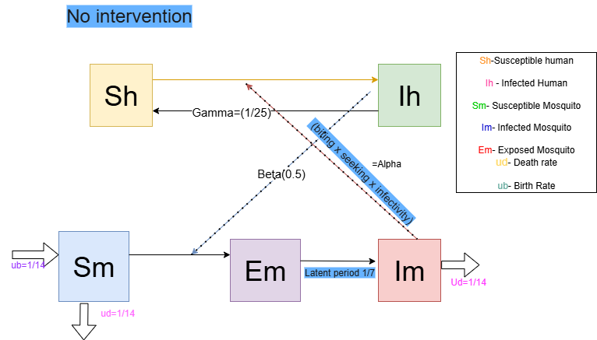
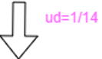

Slide 4
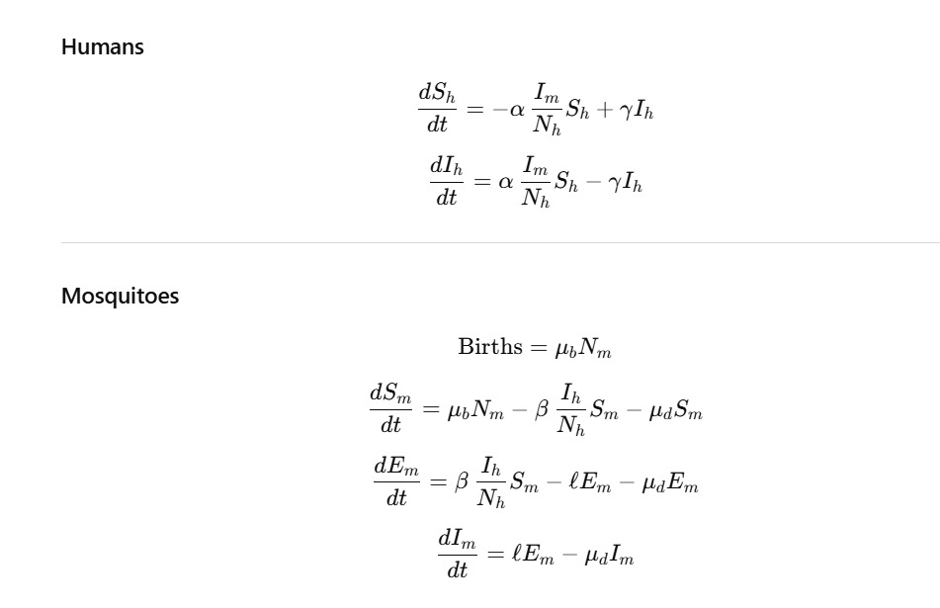
Differential Equations-No Intervention

Slide 5
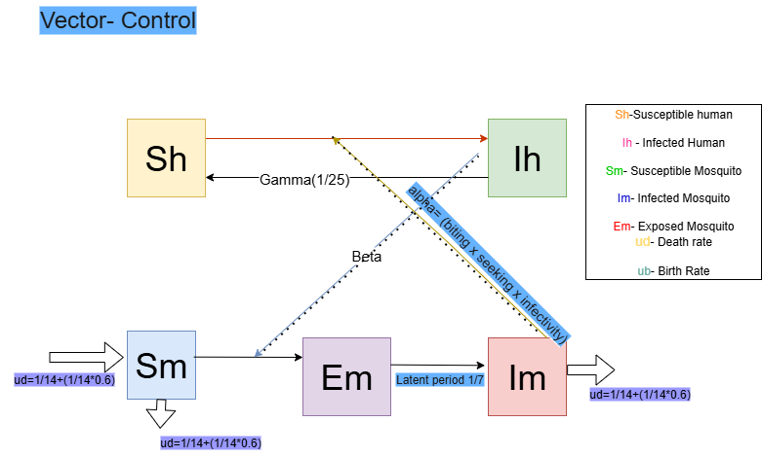

Slide 6
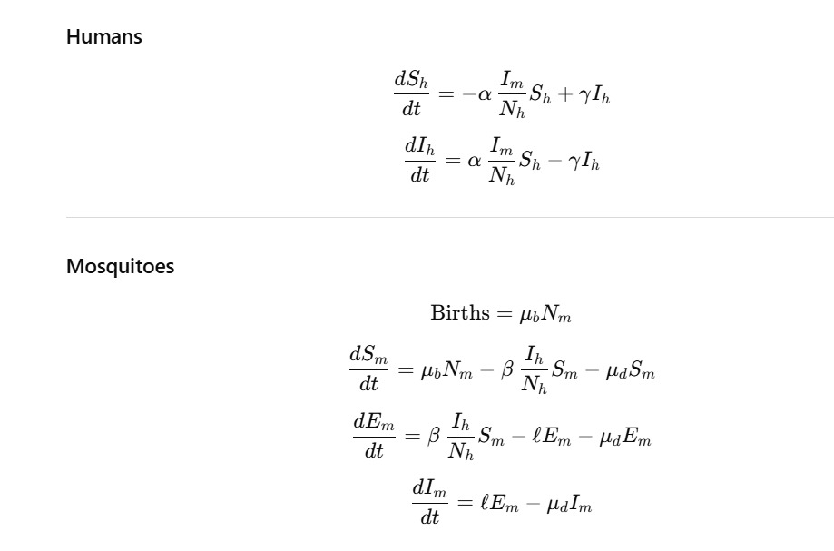
Differential Equations-Vector Control

Slide 7
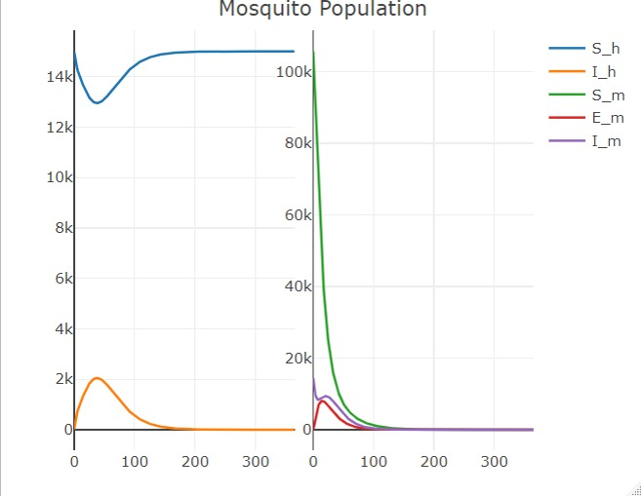
Plot Showing Vector Control Impact

Slide 8
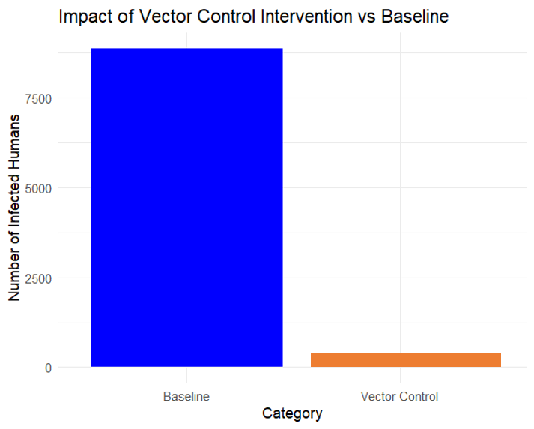
Impact of Vector Control
Cases Averted by Treatment 8877

Slide 9
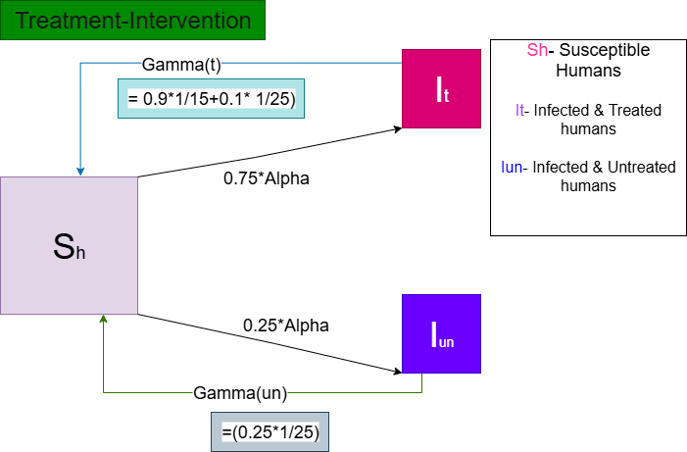

Slide 10
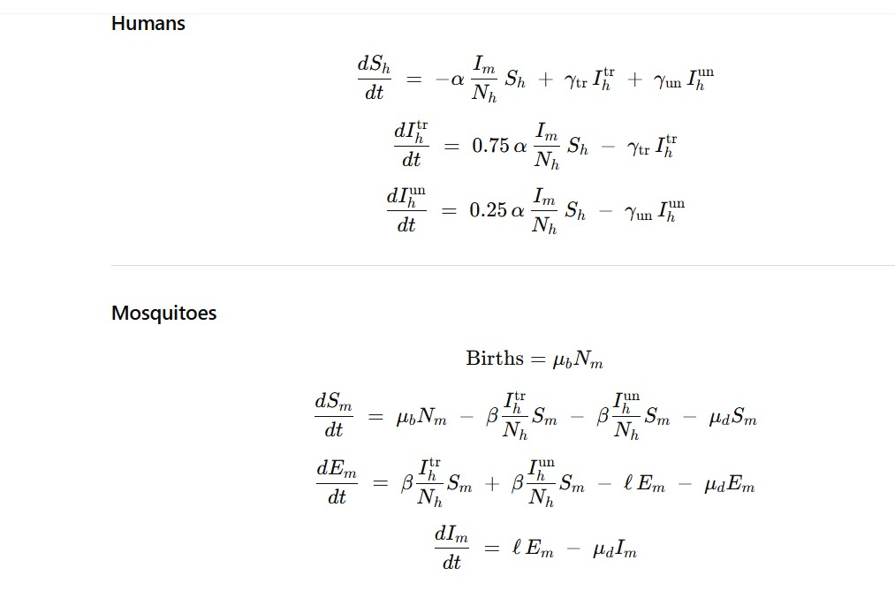
Differential Equations-Treatment

Slide 11
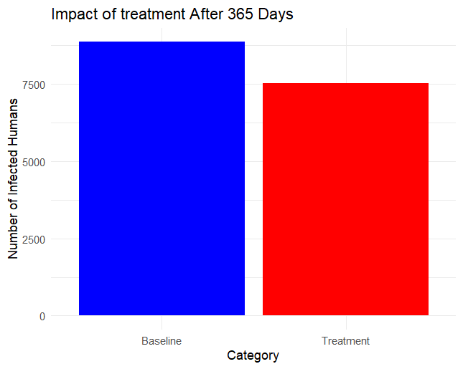
Impact Treatment
Cases Averted by Treatment 1351

Slide 12
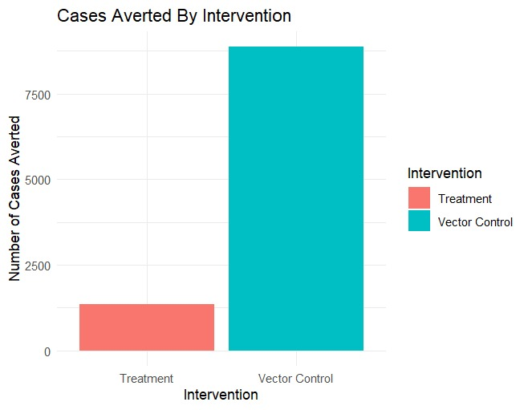

Slide 13
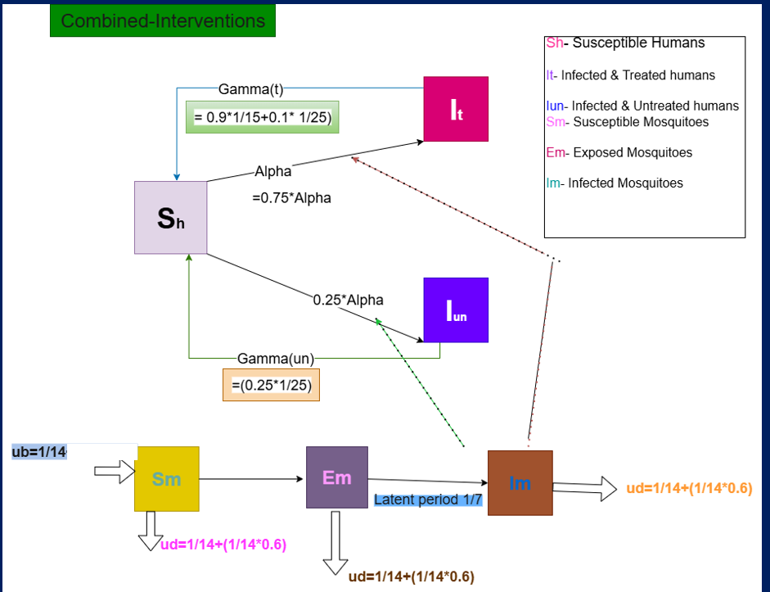

Slide 14


